Slide 1
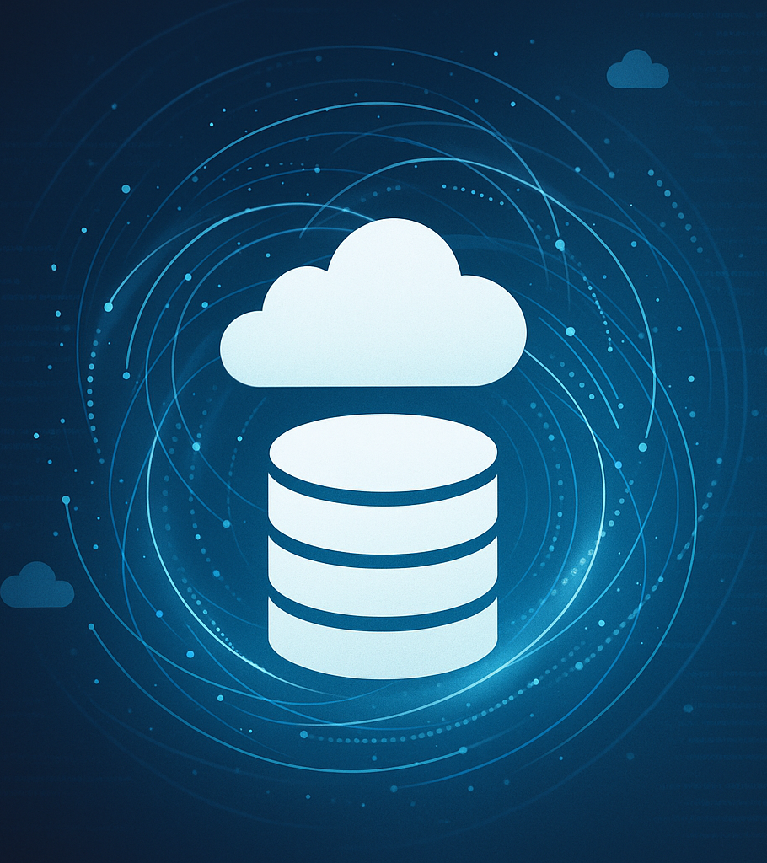
Supabase, PostgREST & Postman
Enhancing PostgreSQL with Auto‑Generated APIs & API Testing
September 2025
Notes:
Welcome, everyone. Today we’re exploring Supabase, PostgREST and Postman—three tools that transform a plain PostgreSQL database into a modern application platform. Supabase extends Postgres with realtime updates, authentication, storage and serverless functionssupabase.com. PostgREST powers Supabase’s REST API by mapping tables, views and functions directly to HTTP endpointsdocs.postgrest.org. Postman is the tool we’ll use to test and document those APIs. By the end of this session you’ll know how to create secure, auto‑generated APIs, write row‑level security policies, map SQL to REST, and build automated Postman tests. These skills apply to roles in software engineering, IT, database administration, project management and cybersecurity.

Slide 2

Supabase: Augmenting PostgreSQL
Auto‑generated REST API via PostgREST: Reflect your schema into REST endpoints without writing code.
GraphQL API: Query your data using GraphQL queries.
Realtime subscriptions & presence: Receive database changes over WebSockets and broadcast messages.
Authentication & Authorization: Email, social, phone and magic‑link logins with row‑level security policies.
Storage & CDN: S3‑compatible file storage with CDN caching and image transformations.
Edge functions & platform tooling: Globally deployed TypeScript functions, daily backups, branching and network restrictions.
[1]
Notes:
Supabase projects start with a full Postgres database, then add services. First, Supabase automatically generates a REST API via PostgREST and a GraphQL API via pg_graphql, so you can query your data over HTTP without writing server codesupabase.com. It offers realtime subscriptions and presence so clients can listen for table changes and broadcast messagessupabase.com. Supabase includes built‑in authentication and authorization, supporting email, social and magic‑link logins, all governed by row‑level security policiessupabase.com. It provides S3‑compatible storage with CDN caching for files and imagessupabase.com. Finally, Supabase offers edge functions and platform tooling—TypeScript functions deployed globally, daily backups, database branching and network restrictionssupabase.com. All of these layers sit on top of your Postgres database, so when you create a table or policy you’re directly controlling your API.

Slide 3

PostgREST: Database as API
Database as single source of truth: API endpoints mirror tables, views and functions, eliminating duplicate business logic.
Declarative & performant: Use SQL and PostgreSQL’s query planner rather than imperatively looping in code.
Leak‑proof abstraction: Define new endpoints using SQL views with predictable performance characteristics.
Focused scope: Handles CRUD and authorization; leave routing and caching to other tools.
[2]
Notes:
Supabase’s REST API is powered by PostgREST. PostgREST is a standalone server that turns your PostgreSQL schema directly into a RESTful APIdocs.postgrest.org. The database becomes the single source of truth: endpoints mirror tables, views and functions—there’s no duplicated business logicdocs.postgrest.org. It encourages declarative programming: instead of iterating in application code, you express logic in SQL and rely on PostgreSQL’s query plannerdocs.postgrest.org. PostgREST enforces a leak‑proof abstraction: you create new endpoints by defining SQL views or functions; there’s no ORM layerdocs.postgrest.org. Finally, PostgREST has a focused scope: it handles CRUD and authorization while leaving routing and caching to other toolsdocs.postgrest.org. This philosophy keeps your API simple and efficient.

Slide 4

Supabase /rest/v1 API
Auto‑generated & instant: Schema changes are reflected immediately in your API.
Self‑documenting: The dashboard generates documentation for your endpoints.
Secure & governed: Enforces row‑level security and key‑based auth via an API gateway.
Fast & scalable: Single SQL statements yield high throughput; ideal for serverless workloads.
Comprehensive capabilities: CRUD operations, nested relationships, views, materialized views, foreign tables and functions with roles and grants.
[3]
Notes:
The /rest/v1 endpoint in Supabase exposes your schema. It’s auto‑generated and instant: create a table or view, and an endpoint appears immediatelysupabase.com. The API is self‑documenting—the Supabase dashboard generates docs for each endpointsupabase.com. It’s secure, enforcing row‑level security and requiring API keys or JWTs via an API gatewaysupabase.com. It’s fast and scalable: each request translates to a single SQL statement, delivering high throughput ideal for serverless workloadssupabase.com. The API is comprehensive: you can perform CRUD operations, filter and order results, query nested relationships, call views and functions, and leverage computed columns and foreign tablessupabase.com. This means that almost anything you can express in SQL can be exposed over HTTP with minimal effort.

Slide 5
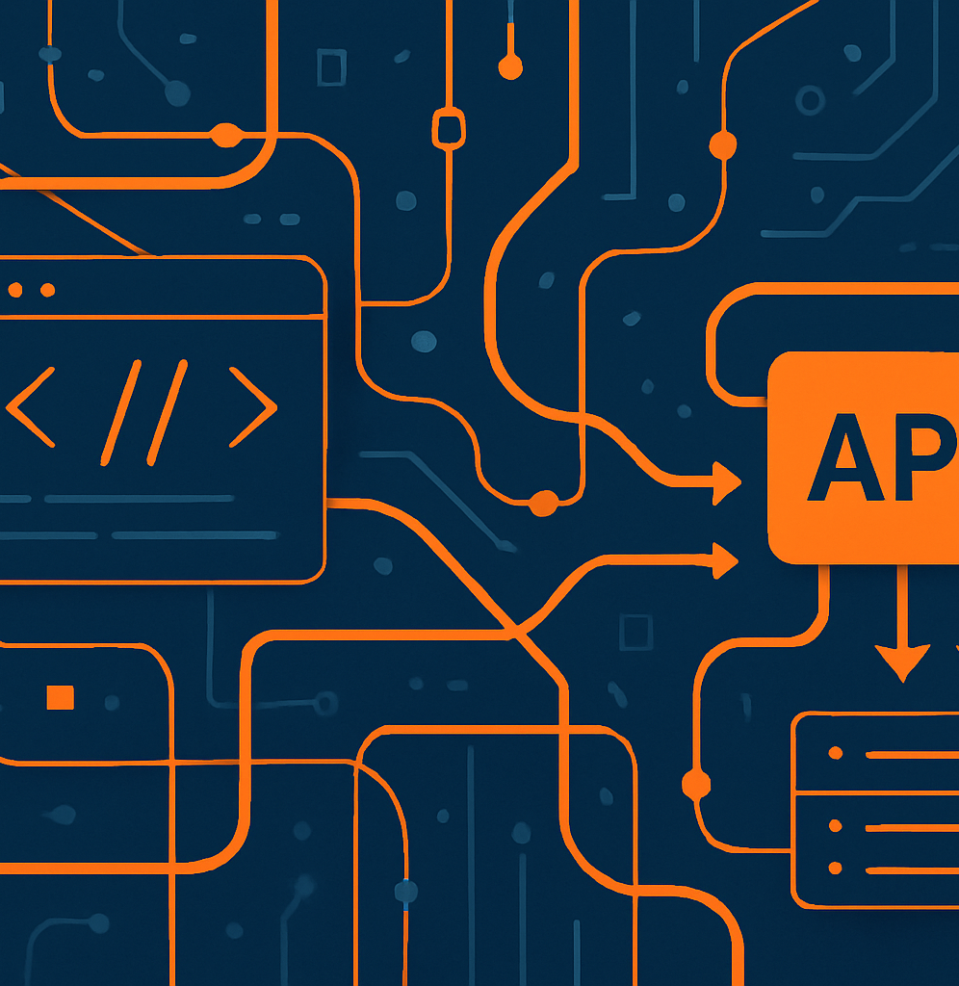
Postman: API Development & Testing
Send & receive requests: Work with GET, POST, PUT, PATCH and DELETE using query params, headers and body data.
Authentication helpers: Attach API keys, tokens, OAuth or Basic Auth effortlessly.
Collections & collaboration: Organize requests into collections, share with teammates and reuse across projects.
Automated tests & monitors: Write JavaScript tests and schedule monitors to validate your API continuously.
Docs & mocking: Generate documentation from your collections and spin up mock servers during development.
[4]
Notes:
Postman is our tool for exploring these APIs. It lets you send and receive requests with HTTP methods like GET, POST, PUT, PATCH and DELETE, specifying query params, headers and JSON bodiesgeeksforgeeks.org. Postman provides authentication helpers for API keys, tokens, OAuth or basic authgeeksforgeeks.org. You can organise requests into collections, share them with teammates and reuse them across projectsgeeksforgeeks.org. It supports automated tests and monitors: write JavaScript test scripts that run after each request and schedule monitors to validate your API continuouslygeeksforgeeks.org. Postman can also generate documentation and mock servers from your collectionsgeeksforgeeks.org. Throughout this course, you’ll use Postman to interact with Supabase and verify that your SQL logic behaves as expected.

Slide 6

Testing Supabase APIs with Postman
1. Find your project’s API URL (https://<project_ref>.supabase.co/rest/v1) and an API key from the Supabase dashboard. 2. Create a new request in Postman and set the URL to an endpoint, e.g., /users?select=id,name. 3. Add an ApiKey header with your Supabase key or use the Bearer token helper. 4. Choose the appropriate HTTP method (GET to read, POST to insert, PATCH to update or DELETE to remove). 5. Send the request and inspect the JSON response; add tests and chain requests as needed.
[3] [4]
Notes:
Here’s how to test Supabase with Postman:
Find your project’s API URL—it looks like https://<project_ref>.supabase.co/rest/v1/—and copy your API key from the Supabase dashboardsupabase.com.
In Postman, create a new request and set the URL to an endpoint, e.g., /users?select=id,name.
Add an apikey header with your Supabase anonymous key or use the Bearer token helper to include a JWT.
Choose the appropriate HTTP method: GET to read, POST to insert, PATCH to update, DELETE to remove.
Send the request and inspect the JSON response. Add tests to assert status codes or field values, and chain requests to build workflows.
You can also create an environment in Postman with variables (base_url, apikey, access_token) to reuse across requests, and schedule monitors to run your collection on a schedule. This workflow will help you validate your APIs as your schema evolves.

Slide 7
Conclusion
Supabase extends PostgreSQL with realtime updates, authentication, storage, edge functions and auto‑generated APIs via PostgREST. The /rest/v1 endpoint exposes your database schema as a secure, performant REST interface that requires no server code. Postman empowers you to explore, test and document these APIs through a rich suite of request helpers, collections, monitors and docs. Together, these tools provide a powerful learning platform for students pursuing software engineering, IT, database administration, project management or cybersecurity roles. In this course you will practice efficient SQL query strategies, implement row‑level security, administer your database and build professional‑grade APIs.
[1] [2] [3] [4]
Notes:
To recap: Supabase extends PostgreSQL by adding realtime updates, authentication, storage, edge functions and auto‑generated APIssupabase.com. The /rest/v1 endpoint exposes your schema as a secure, performant REST interface through PostgRESTsupabase.com. Postman empowers you to explore, test and document these APIsgeeksforgeeks.org. Together, these tools provide a powerful learning platform. Over the course you’ll practise efficient SQL query strategies, implement row‑level security, administer your database and build professional‑grade APIs—skills that are valuable in software engineering, IT, DB admin, project management and cybersecurity.

Slide 8
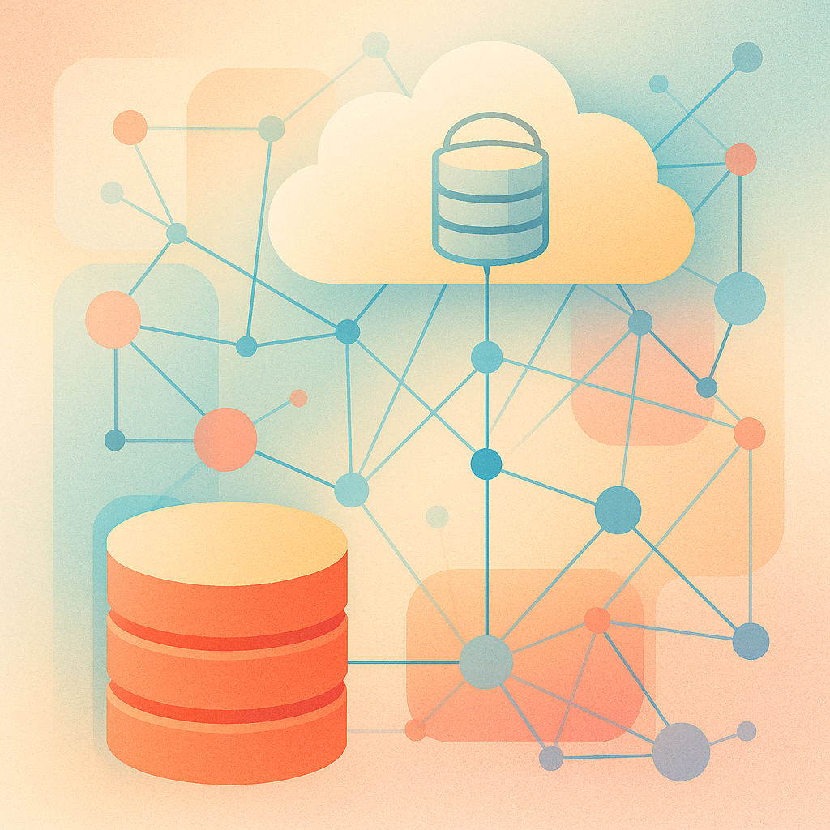
Supabase: Architecture & Features
Full Postgres database with direct SQL access and extensions.
Layers services like authentication, storage, realtime and vector search on top of Postgres.
Database branching & daily backups for safe experimentation.
Integrated dashboard for management and monitoring.
[1]
Notes:
Each Supabase project is a full Postgres database that you can connect to with psql or pgAdminsupabase.com. Supabase layers services on top: it provides authentication and storage, realtime streams of table changes, and even vector search for AI workloadssupabase.com. It supports database branching and daily backups, so you can experiment safely and restore data if needed. The integrated dashboard lets you manage tables, policies, functions and logs, giving you visibility into performance and query plans. Because Supabase builds on standard Postgres, you retain all of Postgres’s features—extensions, indexes, and full SQL—while gaining these platform services.

Slide 9

What Supabase Adds to PostgreSQL
API layer: REST & GraphQL endpoints vs SQL only.
Authentication & RLS integrated with user management.
Realtime streaming over WebSockets.
Object storage with CDN caching.
Edge functions & scheduled jobs.
Vector embeddings & branching for modern workloads.
[1] [3]
Notes:
Supabase differentiates itself from a plain Postgres deployment in several ways. It supplies an API layer—REST and GraphQL endpoints—whereas vanilla Postgres only offers SQL accesssupabase.com. It integrates authentication and row‑level security, mapping JWT claims to roles so you can implement per‑row access control in SQL. Supabase adds realtime streaming via WebSockets, letting clients subscribe to inserts, updates and deletessupabase.com. It includes object storage with CDN caching for files and mediasupabase.com. Supabase provides edge functions and scheduled jobs (serverless functions) to run custom logic near your users. It also supports vector embeddings and database branching, enabling similarity search and isolated development branches. These layers transform Postgres into a backend platform for modern applications.

Slide 10
PostgREST & Declarative Design
Turns your database directly into a RESTful API; endpoints mirror tables, views and functions.
Database as single source of truth — no duplicate business logic or ORM layers.
Declarative programming: rely on SQL and the query planner instead of imperatively looping through records.
Leak‑proof abstraction: create new endpoints by defining views in SQL.
Focused scope: PostgREST handles CRUD and authorization, letting other tools manage routing and caching.
[6]
Notes:
PostgREST’s design is declarative. Your database schema becomes the API: tables, views and functions automatically map to endpointsdocs.postgrest.org. There’s no duplicate logic or ORM; you define business rules in SQL, and PostgREST enforces themdocs.postgrest.org. When you need a new endpoint, you create a view or function rather than writing application code. Because PostgREST calls a single SQL statement per request, it relies on PostgreSQL’s query planner for performancedocs.postgrest.org. This approach keeps your API simple, ensures permissions and constraints are enforced consistently, and reduces the amount of infrastructure you need to maintain.

Slide 11
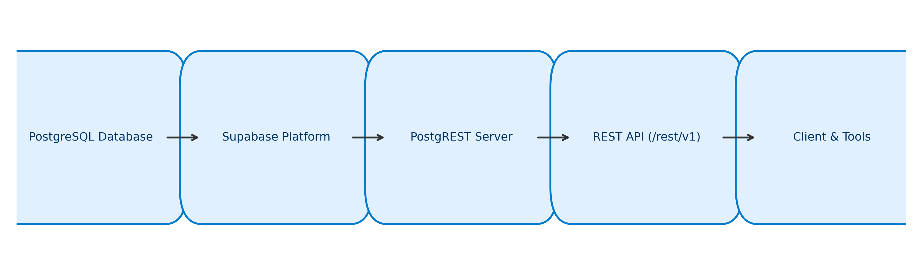
System Architecture
Data flows from PostgreSQL through the Supabase platform and PostgREST to the /rest/v1 API, which can be consumed by clients like Postman.
[6] [1]
Notes:
Look at how the components connect. Your data resides in a PostgreSQL database. Supabase layers services like authentication and storage on top. The PostgREST server exposes tables, views and functions as REST endpoints. Supabase’s API gateway surfaces those endpoints at /rest/v1, adding key‑based auth and JWT handling. Clients—your web app, mobile app or Postman—consume these endpoints. A request to /rest/v1/todos becomes a SQL query executed in the database, and the result flows back through PostgREST to the client. This architecture ensures that your API always reflects your schema changes and that there’s a single source of truth.

Slide 12
Row Level Security & Policies
Enable RLS on a table: ALTER TABLE <table> ENABLE ROW LEVEL SECURITY;
No data is accessible via the anon key until policies are defined.
Requests are mapped to Postgres roles: anon and authenticated.
Policies are SQL expressions evaluated as WHERE clauses.
-- Enable RLS and define policies ALTER TABLE public.todos ENABLE ROW LEVEL SECURITY; CREATE POLICY todo_select_own ON public.todos FOR SELECT USING ((auth.uid()) = user_id); CREATE POLICY todo_modify_own ON public.todos FOR ALL USING ((auth.uid()) = user_id);
[4] [5]
Notes:
Row‑level security (RLS) allows you to control access at the row level. To enable it on a table, run:
ALTER TABLE <table> ENABLE ROW LEVEL SECURITY;
supabase.com
Once enabled, no data is accessible via the anonymous key until you define policiessupabase.com. Supabase maps requests to Postgres roles: anon for unauthenticated users and authenticated for logged‑in userssupabase.com. Policies are SQL expressions that act as WHERE clauses; they run on every request. For example, to let users view and modify only their own todos, you’d write:
ALTER TABLE public.todos ENABLE ROW LEVEL SECURITY;
CREATE POLICY todo_select_own ON public.todos FOR SELECT USING ((auth.uid()) = user_id);
CREATE POLICY todo_modify_own ON public.todos FOR ALL USING ((auth.uid()) = user_id);
supabase.com
Here auth.uid() returns the UUID of the authenticated user, so these policies ensure each user sees only their rows. We will practise writing policies for different scenarios.

Slide 13
From SQL to REST: Examples
SQL
REST
SELECT id, task FROM todos WHERE is_done = FALSE ORDER BY inserted_at DESC;INSERT INTO todos (user_id, task) VALUES ('<uuid>', 'Finish homework');SELECT * FROM search_todos('homework');
GET /rest/v1/todos?select=id,task&is_done=eq.false&order=inserted_at.descPOST /rest/v1/todos
{ "user_id": "<uuid>", "task": "Finish homework" }
POST /rest/v1/rpc/search_todos
{ "q": "homework" }
[3] [4]
Notes:
Mapping SQL queries to REST calls helps you leverage your SQL knowledge. Consider:
SELECT with filter and order: SQL: SELECT id, task FROM todos WHERE is_done = FALSE ORDER BY inserted_at DESC; REST: GET /rest/v1/todos?select=id,task&is_done=eq.false&order=inserted_at.desc
INSERT a row: SQL: INSERT INTO todos (user_id, task) VALUES ('<uuid>', 'Finish homework'); REST: POST /rest/v1/todos with body { "user_id": "<uuid>", "task": "Finish homework" }
Call a stored procedure: SQL: SELECT * FROM search_todos('homework'); REST: POST /rest/v1/rpc/search_todos with body { "q": "homework" }supabase.com
Notice how filters (is_done=eq.false) and ordering translate to query parameters, and how RPC calls are performed via /rpc/<function> with a JSON payload. This equivalence allows you to move between SQL and REST seamlessly.

Slide 14

Postman Features & Workflows
Collaborate: Create workspaces, comment on requests and share collections.
Design APIs: Use Spec Hub and API Builder to define your API specification.
Documentation: Generate and publish API docs from collections.
Monitoring: Schedule monitors to run tests and track performance.
Governance & Security: Apply organization‑wide rules and security checks.
Administration & Reports: Manage team access and view usage analytics.
[7] [7]
Notes:
Postman supports the entire API lifecycle. You can collaborate by creating shared workspaces, commenting on requests and sharing collectionslearning.postman.com. The Spec Hub and API Builder let you design your API specification and keep it aligned with your implementationlearning.postman.com. Postman can generate and publish documentation from your collectionslearning.postman.com. You can schedule monitors to run tests at regular intervals and track performance metricslearning.postman.com. Postman also offers governance and security features, applying organisation‑wide rules and performing security checks, and provides administration and reporting to manage team access and view usage analyticslearning.postman.com. Using these workflows will help you maintain high‑quality APIs in professional environments.

Slide 15
Using Postman with Supabase
Retrieve your project URL and API keys from the Supabase dashboard.
Create a Postman environment with variables for base_url, apikey, access_token and service_role.
Construct requests: set URL to {{base_url}}/rest/v1/<table> and include the apikey and Authorization headers.
Write tests using the pm API to validate responses and chain requests.
Schedule monitors to run your collection on a schedule and receive alerts.
[7] [3]
Notes:
To get the most from Postman:
Retrieve your project URL and API keys from the Supabase dashboard.
Create a Postman environment with variables for base_url, apikey, access_token and service_role.
Construct requests: set the URL to {{base_url}}/rest/v1/<table> and include headers apikey: {{apikey}} and Authorization: Bearer {{access_token}}. Use query parameters for filters and sorts, and JSON bodies for inserts and updates.
Write tests using the pm API to validate responses. For example:
pm.test('returns 200 OK', () => pm.response.to.have.status(200));
pm.test('has expected fields', () => {
const json = pm.response.json();
pm.expect(json.length).to.be.above(0);
});
Schedule monitors to run your collection on a schedule and receive alerts when tests fail.
These practices ensure your Supabase APIs remain reliable as your database schema evolves and your application scales.

